Slide 1
FOREX SMA Strategy and Analysis
Mike Blanchette
Soheil Gityforoze
Halam Kim
Francisco Franco Mesa

Slide 2
FOREX Market
What is FOREX Market?
Foreign exchange market → currency trading → currency exchange rates
Global marketplace for national currencies
How does it work?
Supply and demand
Buy / Sell → Exchanged currencies at a determined price

Slide 3
Our Goal for this Project
To come up with a SMA (Simple Moving Average) strategy in order to optimize our currency pair trading portfolio
The steps were:
Data Analytics
Applying SMA trading strategy
Finding the correlation between the currency pair and the government’s bond interest rate
Compare with the market/low-risk bond
Notes:
Our goal was to come up with a SMA (Simple Moving Average) strategy, which is trading whenever small and long SMAs cross. This was similar to doing the rolling method with stocks that we covered in the past.
SMA = simply the average price over the specified period

Slide 4
From Kaggle, we found csv files of the top 7 currency pairs
AUD/USD
EUR/CHF
EUR/JPY
EUR/USD
USD/CAD
USD/CHF
USD/JPY
Notes:
Each pair had about 50,000 rows of data, and we had data for every 15-min interval.

Slide 5
Data Analytics

Slide 6
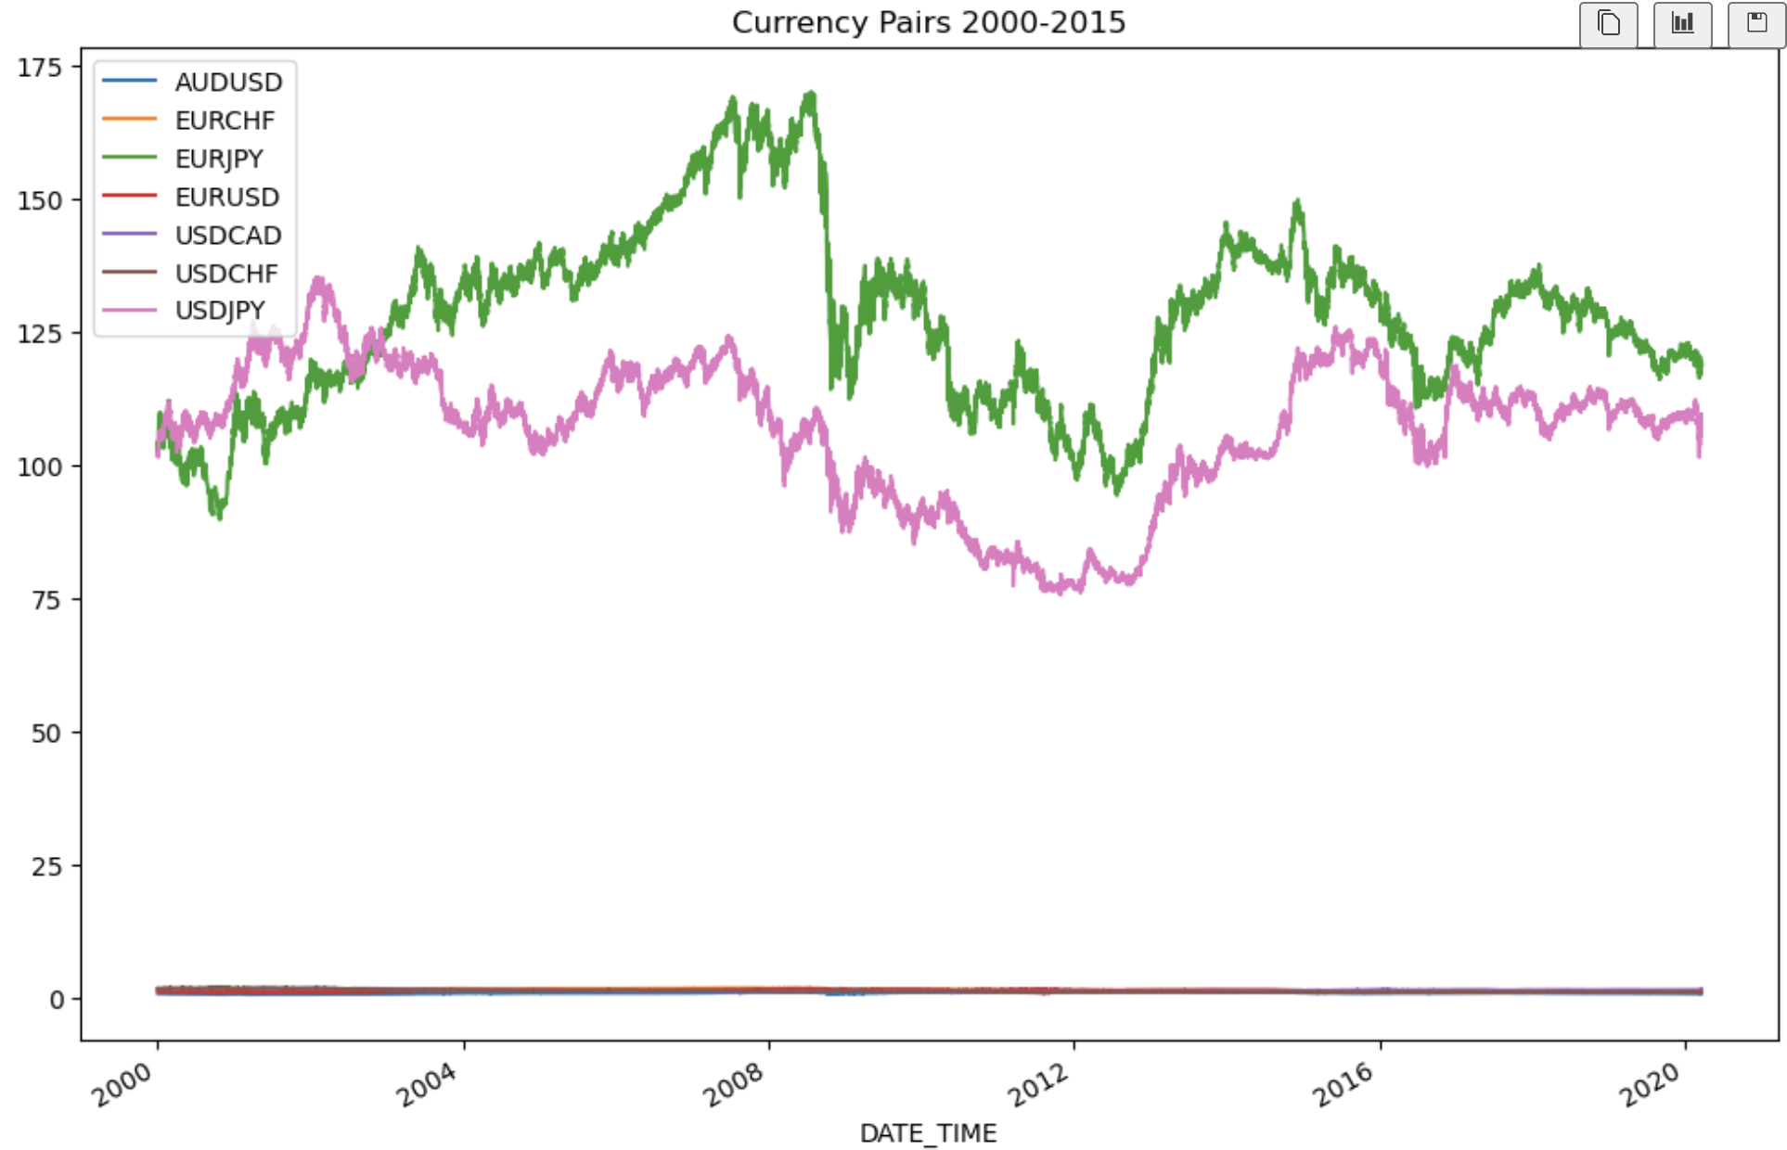
Notes:
Here is a graph of all 7 currency pairs in one paragraph. As you can see, JPY-related data has a much higher conversion rate so I had a separate chart that shows the other 5.

Slide 7
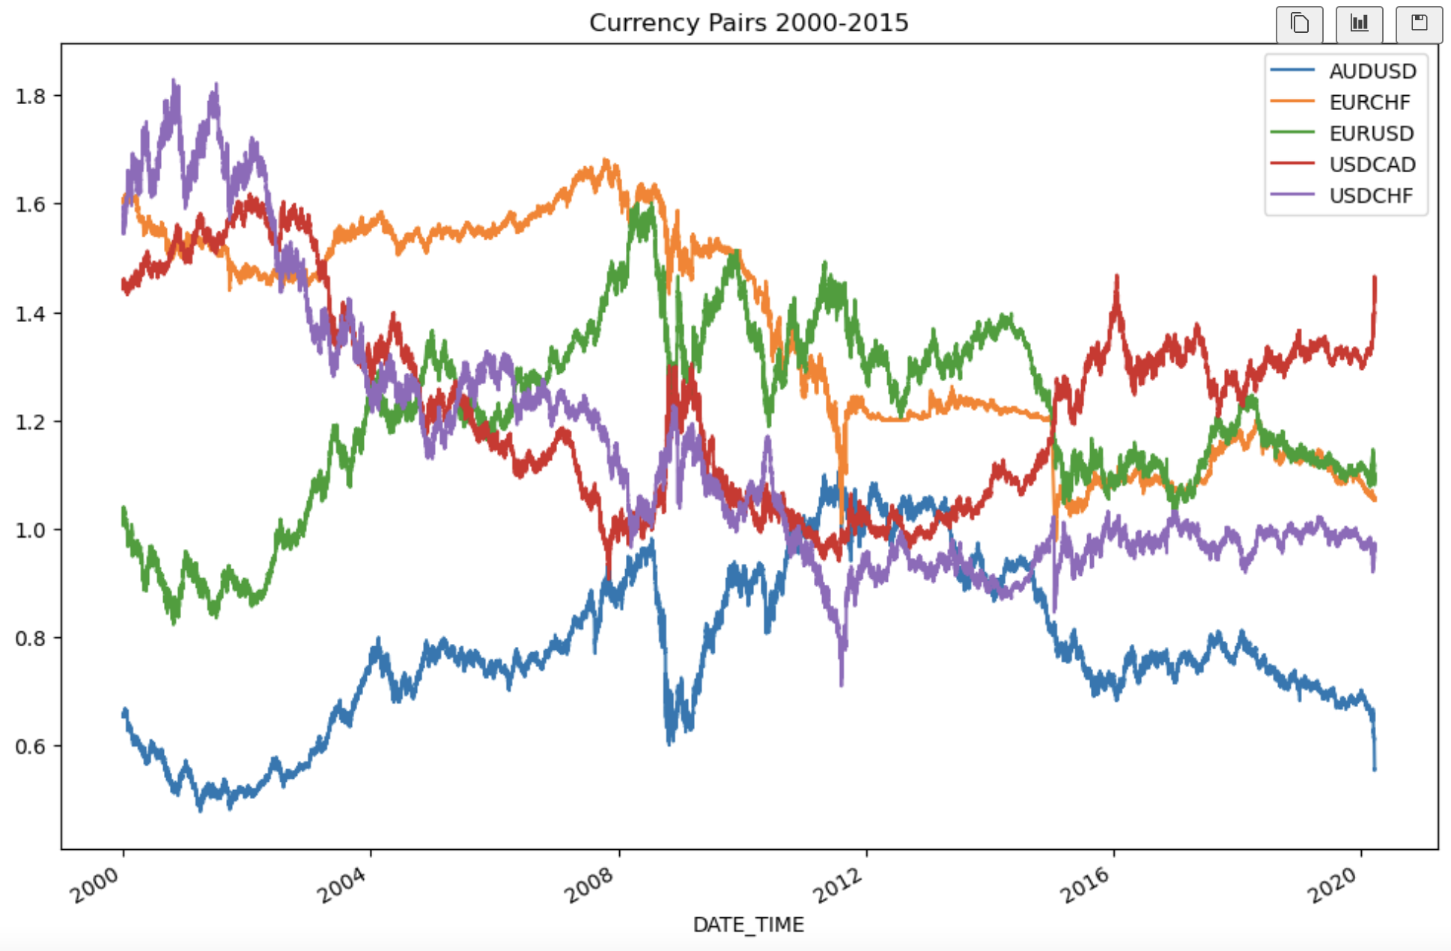
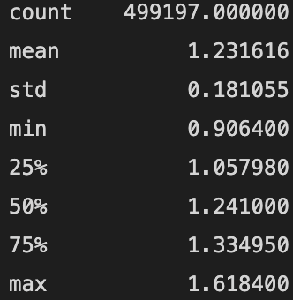
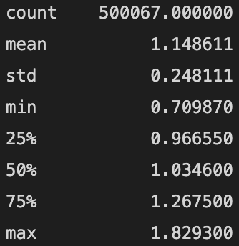
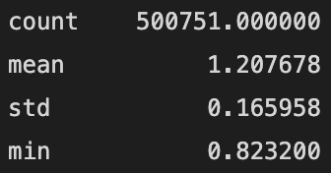
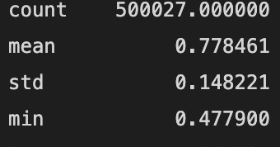
USDCAD
USDCHF
EURUSD
AUDUSD
Notes:
Purple and red are relatively not too far off - both are conversions from USD to CAD or CHF
Red - USDCAD - mean 1.23 std 0.181 max 1.6184 (beginning) min 0.906 (the end)
Purple - USDCHF - mean 1.14 std 0.248 max 1.8293 (beginning) min 0.709 (the end) - explains the bigger std than red
Blue and green relatively similar in the pattern except for 2008-2010 ish (from AUD/EUR to USD)
Blue - AUDUSD mean .778 std .148
Green - EURUSD mean 1.2 std .166

Slide 8
Find conservative or risky
Concatenate all 7 currency pairs into one DataFrame
Find the percent change from row to row.
Find the standard deviation and variance.
Result (order from most conservative to most risky):
EURCHF, USDCAD, EURUSD, USDJPY, USDCHF, EURJPY, AUDUSD

Slide 9
Linear Regression Model

Slide 10
Linear regression model
Utilize linear regression to forecast price-action
Import required libraries
from sklearn.linear_model import LinearRegression
Import currency pair data (AUD/USD)
Plot price-action graph
Find variables → fit regression model
Find “x” → previous close to determine “y”→ np.array using ‘low’, high’, ‘open’, ‘close’
Find “y” → Actual target or close figured out with “x” → np.array using AUDUSD[‘1day’]
Fit regression model → LinearRegression() with “x” and “y” variables
Coefficient of determination, intercept, slope
Coefficient of determination → R^2 = 0.99837
Intercept→ b0
Slope → b1

Slide 11
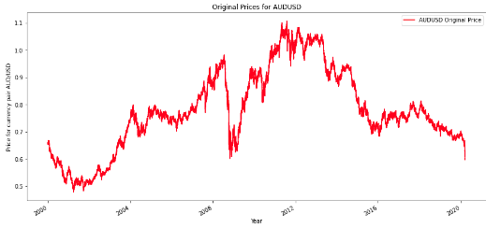
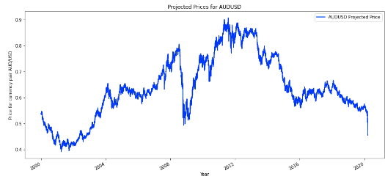
𝑓(𝑥) = 𝑏₀ + 𝑏₁𝑥
Plot original closing prices vs projected closing prices

Slide 12
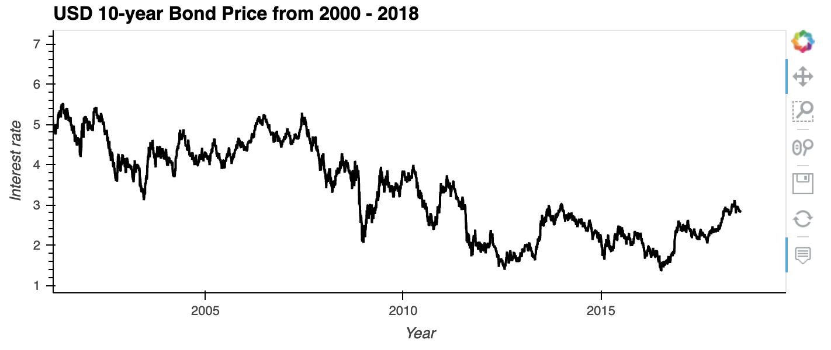
Alternative predictions → 10-year USD/EUR bonds

Slide 13
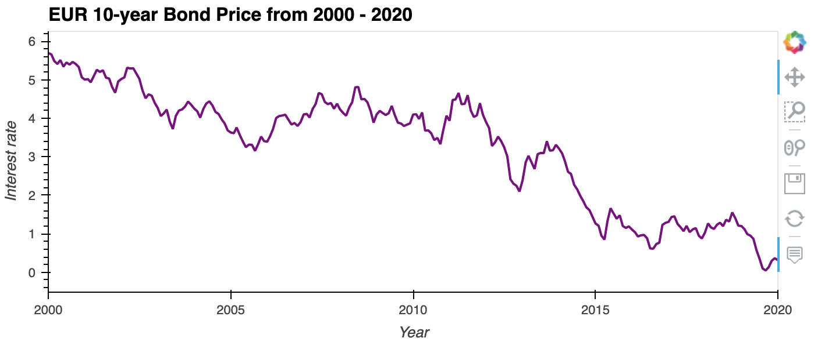

Slide 14
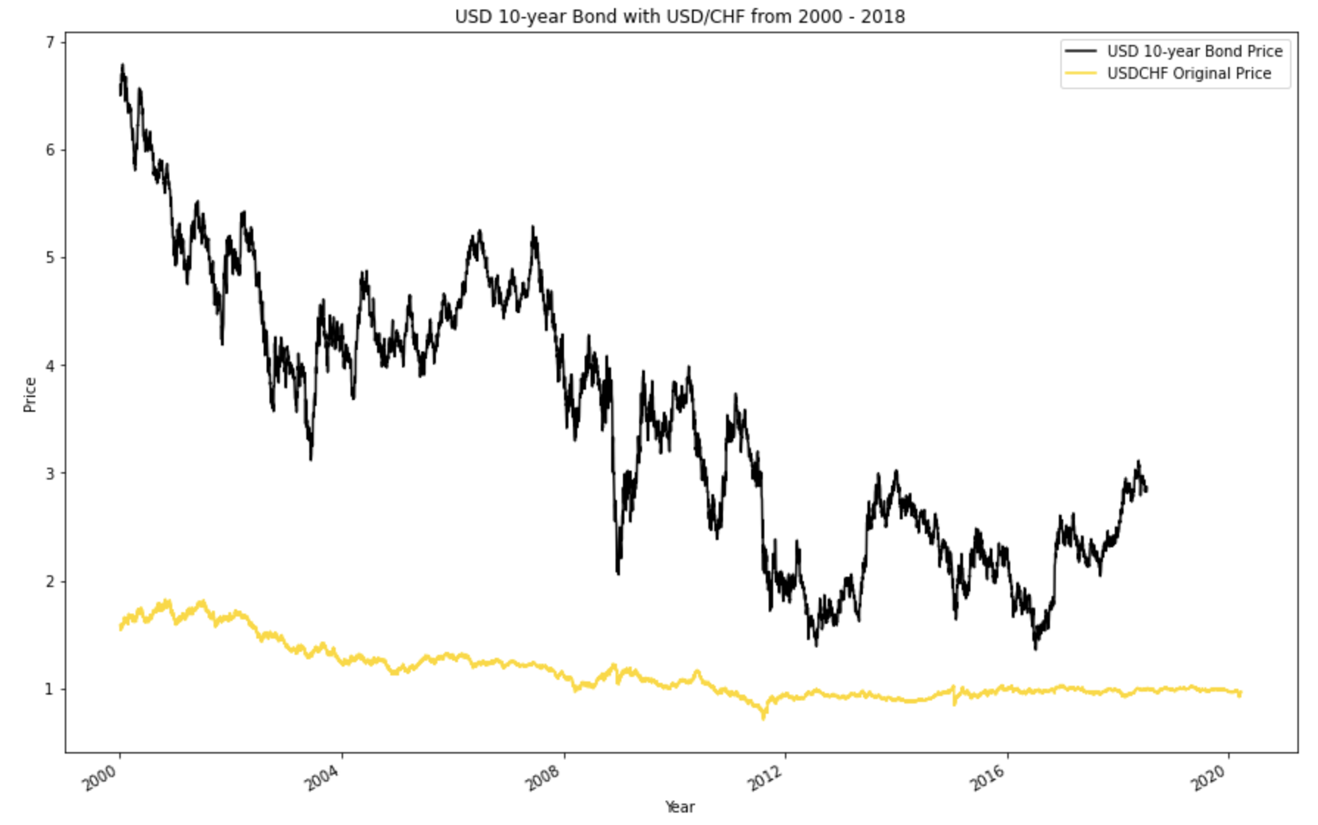
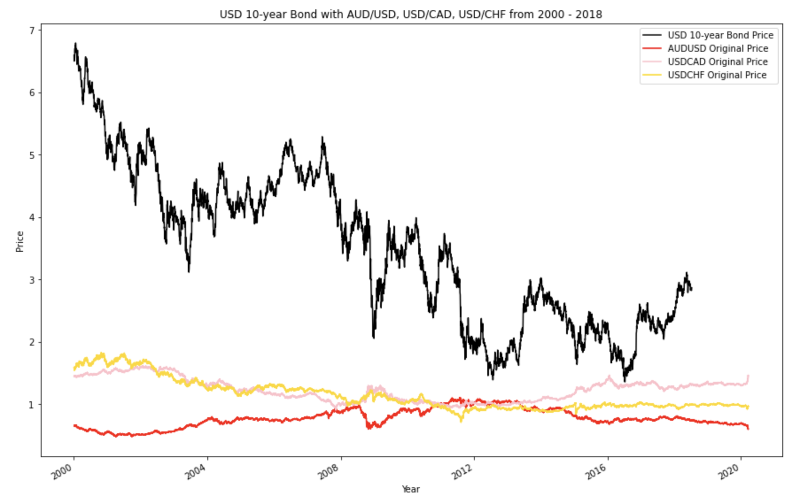
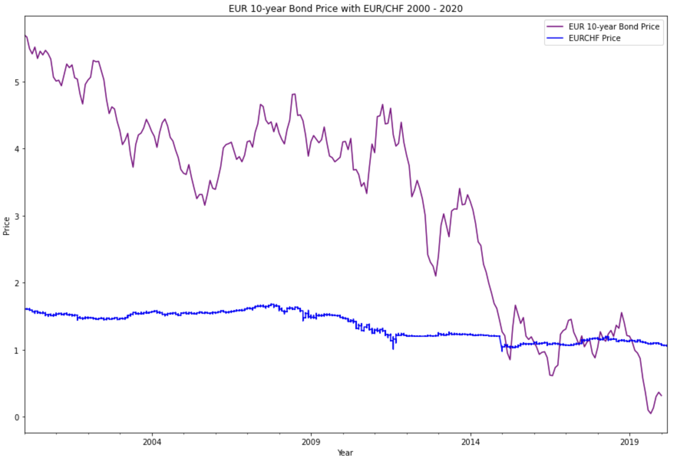
USD 10-year Bond
vs
Currency Pairs

Slide 15
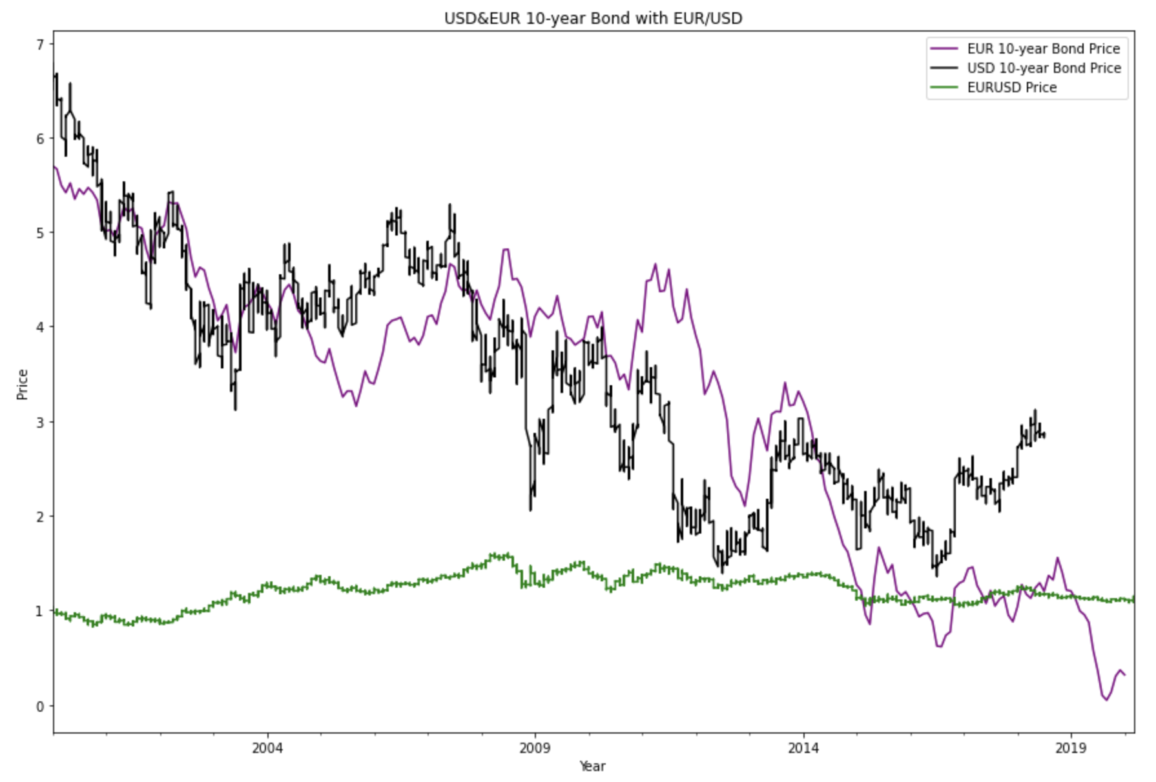

Slide 16
SMA Strategy

Slide 17
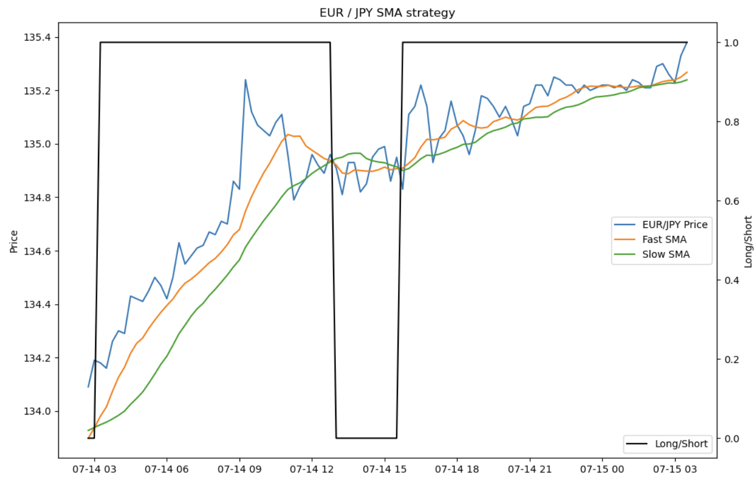
SMA Strategy
Fast SMA: 50
Slow SMA: 100

Slide 18
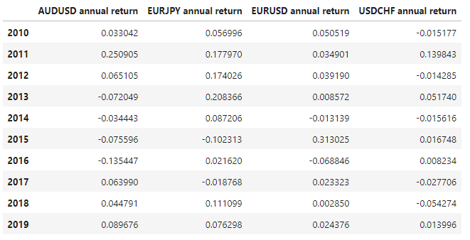
Calendar Year Returns

Slide 19
Performance Analysis

Slide 20
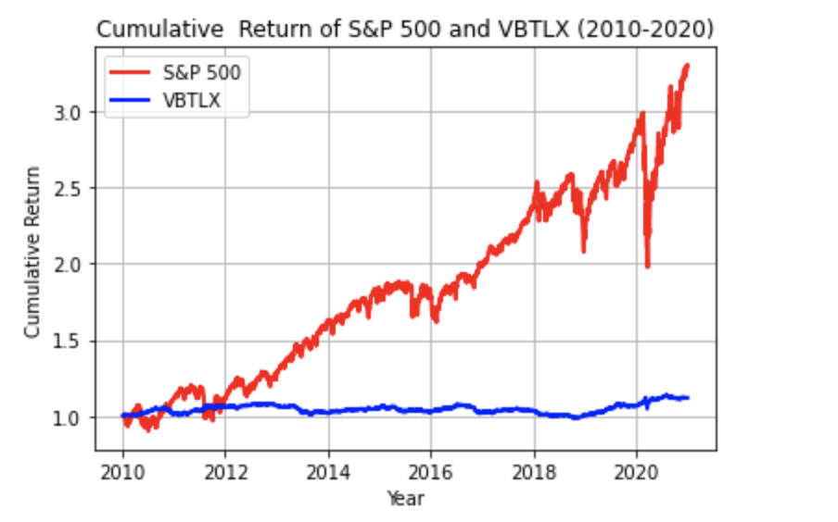
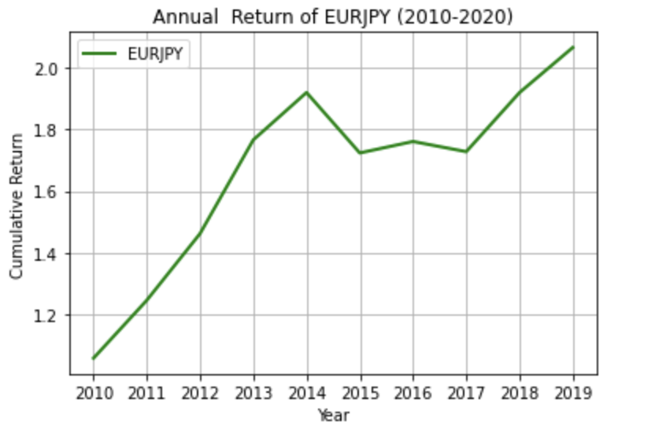
S&P500, VBTLX, Vs EURJPY
(2010-2020)

Slide 21
Next Steps:
Use the ADR (Average Daily Range) numbers we found to determine volatility estimation, position sizing, and trend identification
Make a working Linear Regression Model
Try smaller SMA intervals in order to beat the market (take fees into account)

